Slide 1
Bank Churners
Will they leave or not?

Slide 2
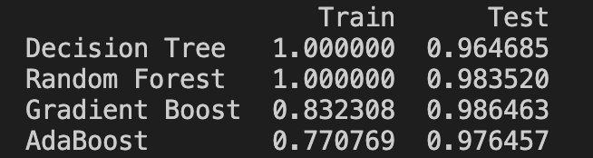
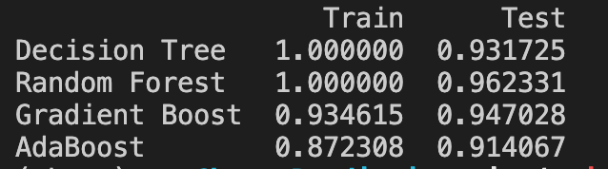
Deciding the classifier
1. Without balancing the data
2. After balancing the data

Slide 3
What about clusters?
K-Means:

Slide 4
Demonstration
Only local (for now):
http://192.168.0.21:9050/

Slide 5
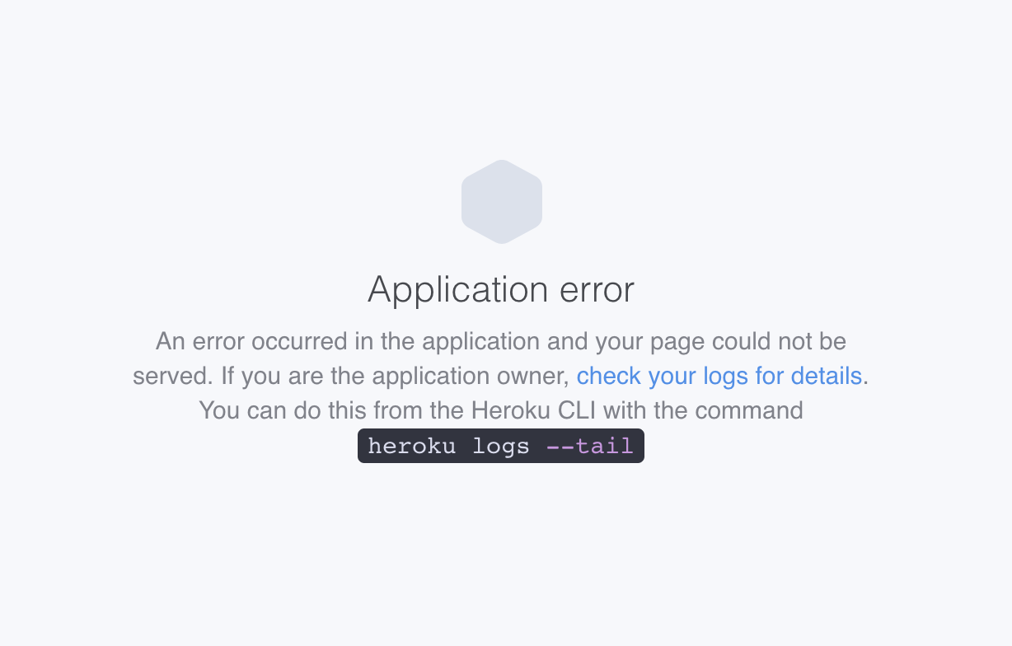
Issues to be solved
Docker: local time-out
Heroku:

Slide 6
Probable solutions
Deployment:
joblib (.yaml)?
dash?
…
Programming:
drop SHAP values, serialize, …

